Slide 1
Marketing Operations
Open Office Hours
Understanding the MQL Journey
14-FEB-2024
Taylor Wright, Assoc Manager Business Development
Garrett Brennan, Director Marketing Operations

Slide 2
Agenda
Welcome
Best Practice: Understanding the MQL Journey
Open Q&A/Discussion

Slide 3

Marketing Automation Open Office Hours
Have your questions answered by the marketing automation team. MA Open Office Hours are held monthly with the following agenda:
Learn about a tip or best practice
Ask a question – Pre-submit your questions here or ask during the office hours
Learn how to leverage IQVIA’s marketing systems and processes most effectively
Action: Sign up here, if you need to be added to the outlook invite
Next Open Office Hours: March 6th @ 9:00am EST, Sathya will present SEO best practices

Slide 4
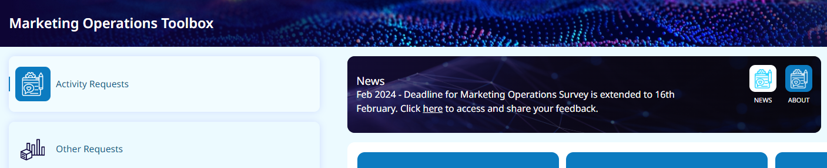
Marketing Operations Survey – Deadline is Friday 16-Feb
Please help us and provide feedback
Access here: Marketing Operations Survey
Or go to the Marketing Operations Toolbox

Slide 5
Understanding the MQL Journey
Taylor Wright, Assoc Manager Business Development
Garrett Brennan, Director Marketing Operations

Slide 6
MQL Journey
MQL Generating Campaigns & Process
Inside Sales Pipeline Team
Campaign Triage vs Playbook
Inside Sales Follow Up
Tracking & Reporting

Slide 7
MQL Generating Campaigns

Slide 8

What is a Marketing Qualified Lead (MQL)
A prospect/customer identified by marketing that fits a defined profile and level of engagement agreed to by both marketing and sales and is ready to be turned over for sales activity.
Most importantly, the prospect/customer is accepted by sales for further qualification.
We focus on hand-raisers.
If a prospect/customer is a “hand-raiser”
- they have explicitly asked up to follow-up on a specific business need and/or indicated an upcoming RFP

Slide 9
MQL Generating Campaigns
MQLs are generated based on incoming data to Eloqua.
Webinar/Event
(ON24, Cvent & MJH/GlobalMeet auto integrated w/ Eloqua)
External Activity File Uploads
(Marketing Activities that are not integrated)
www.iqvia.com/contact/rfp
e.g. www.iqvia.com/contact/sf
MQL Form Submits (From iqvia.com, Q2, or Marketing Campaign Form)
Explicit Request for Follow-up
Explicit Request for Proposal
Prospects that meet MQL “Handraiser” definition
Marketer completes file with required data and submits to MO
Inside Sales Pipeline Team
All three types of marketing qualified leads (MQLs) will be sent directly to Inside Sales as Salesforce Task Records. MQL tasks can be generated on a Salesforce Lead or Contact Record.

Slide 10
Inside Sales Pipeline Team
Robert Thompsen
Sr. Director, Business Development
Taylor Wright
Assoc. Manager, Business Development
Caroline
Robbins
BDS 1, RDS
Dylan
Wallace
BDS 1, RDS
Nicholus
Locascio
BDS 1, RDS
Hannah
Hawkins
BDS 1, RWS
Bradley
Yelverton
BDS 1, PCS
Ashley
Doherty
BDS 1, ClinTech

Slide 11
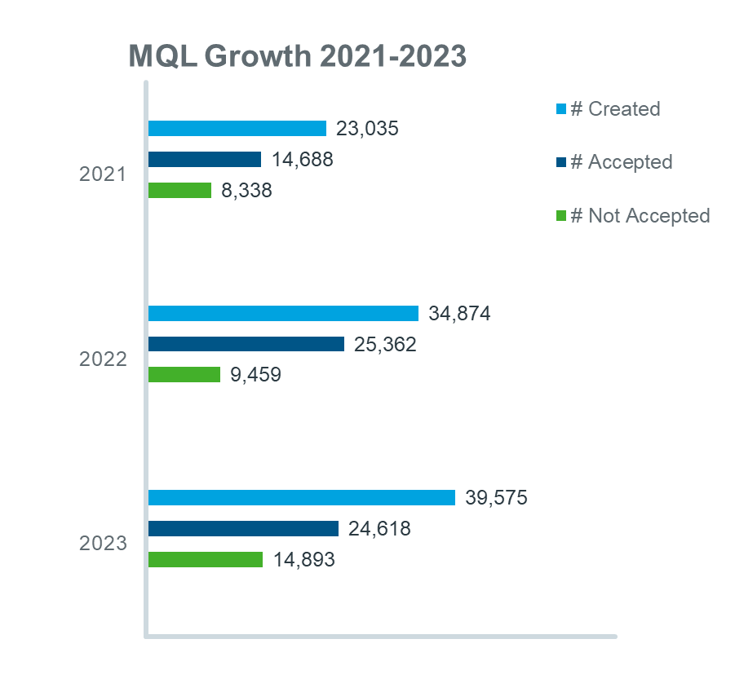
MQL Growth from 2021-2023
~70% Increase in only two years

Slide 12
Campaign Triage vs. Campaign Playbook

Slide 13
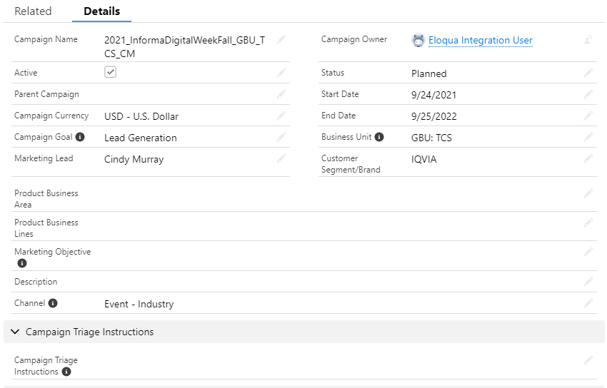
Campaign Triage Instructions – Details Tab
New Field in CRM for Marketers to complete after Campaign is setup in Salesforce
Inside Sales Pipeline team handles the triaging of all IQVIA leads enterprise wide
Triage instructions are critical for the Pipeline team to properly direct your MQLs
Must know prior to campaign hitting the lead queue
Strongly Recommend following the standard process leveraging Inside Sales for initial follow up
Consistent, managed process and timeline
Effective Salesforce updating
For very specific business cases, custom triage possible
Assign to person X (after ensuring they have access)
You will be responsible for ensuring follow up and Salesforce updating
Taylor Wright leads the Pipeline team

Slide 14
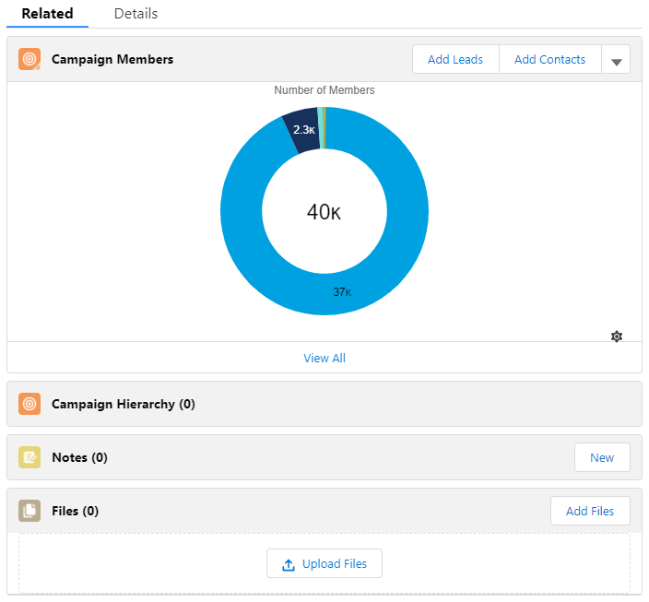
Campaign Playbook - Related Tab/Files
New Field in CRM for Marketers to complete after Campaign is setup in Salesforce
You can now upload your Campaign Playbook to the “Files” section under a Campaign in Salesforce!
Easy access for inside sales BDs and easy for marketers to update if changes need to be made!
Playbooks are incredibly useful for GIS to leverage in effectively engaging on initial outreach
Playbooks consist of webinar/campaign overview details, follow up messaging, and who GIS should loop into the conversation when a response has been received back from a lead

Slide 15
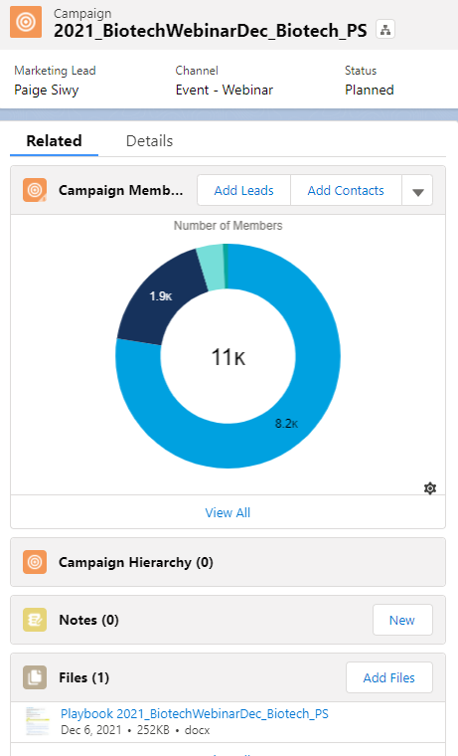
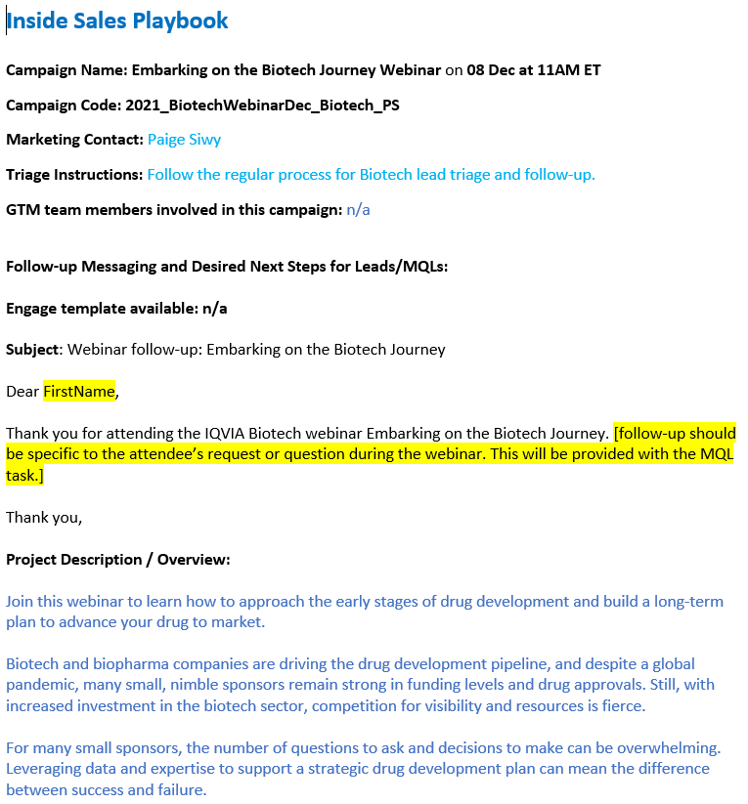
Campaign Playbook - Related Tab/Files
Example of a Campaign Playbook

Slide 16
Sample Playbook - pg.1
Creating Playbooks as Word documents is likely the most simple
Inside Sales Playbook:
Campaign Name: Embracing Change And Dealing With It
Campaign Code: 2022_SRQRegJulyWebinarEnterprise_MT_GBU_RWS
Marketing Contact: Mary Toto
Triage Instructions: Direct sales assignments where noted. Inside sales to handle follow-up where noted and triaging qualified MQLs to Scott Higgins / Sandy Brown
GTM team members involved in this campaign:
PRIMARY/CAMPAIGN LEAD Mary Toto, Marketing Manager
Miyuki Bryan, Marketing Coordinator
Michael King, SME for RIM Smart for Med Tech

Slide 17
Sample Playbook - pg.2
Follow-up Messaging and Desired Next Steps for Leads/MQLs:
Subject Line: Thank you for your interest in our webinar. Let’s continue the conversation.
Hi <NAME>,
Thank you for your interest in our webinar entitled “Embracing Change And Dealing With It.”
We hope our webinar demonstrated how you can simplify your Change Management across your SRQ systems while ensuring ease of implementation, global compliance and preparedness for future tarted changes.
You may also find value in reading our blog post from experts Mike King and Kari Miller, Optimizing Medical Device Product Change Workflows – Integrations Across Safety, Quality and Regulatory.
Are you interested in speaking to an IQVIA expert from our Regulatory Technology team more? Please reply to this email and we will set up a conversation. we will set up a conversation.
Please let me know if you have a specific need in this space and I look forward to our continued conversation.
Thank you,
<NAME>

Slide 18
Sample Playbook - pg.3
Project Description / Overview: This is specifically for follow up on those who registered for the Med Tech webinar series, specifically webinar 1 of the series.
Webinar abstract and registration page: MedTech Market Access Trends In 2022
Webinar PPT deck: Embracing Change and Dealing With It PPT
Target Audience: Phillipe, Dan
Solution(s) being promoted: RIM Smart
Relevant solutions messaging: IQVIA RIM SMART FACT SHEET
Capabilities to highlight:
Constant changes in global health authority requirements and a lack of resources make the task of putting regulatory data to work even harder.
RIM Smart can help your organization remain compliant, guarantee the accuracy of its regulatory information, manage costs, and still streamline the regulatory approval process.
For Scott/Sandy:

Slide 19
Sample Playbook – PPT Edition
Same info required as word document version
Campaign element | Description
Marketing Contacts | Pauline Fahey, Susan Harrell
Campaign Type | Lead Generation LinkedIn Sponsored Advertising campaign
Campaign Code | 2022_RWELeadGenAds_GBU_RWS_PF
Campaign Start Date | November 3
Campaign End Date | December 6
Target Audience | Diana (Medical Affairs), Sara (RWE), Edward (HEOR), Paul (Market Access), Helen (Therapy Area Expert), Gilbert (Clinical Operations – Large)
Solutions Promoted | Real World Solutions
Campaign Countries | UK, France, Italy, Spain, Switzerland, Netherlands, Denmark, Germany, Belgium, Sweden, Poland USA, Canada
2 Waves | Wave 1 (9 advertisements) – RWE, RWD to meet Regulatory and Payer requirements Large and Mid clients Wave 2 – in preparation
Call to actions | Let’s Talk

Slide 20
Sample Playbook –PPT cont.
MQLs will come through for the advertisements
You have our latest RWS Account Director List
Follow-up with leads and reach out to them
Initial Outreach by Inside Sales and upon response loop in Account Director
US – initial outreach by Tyler Fleming
EU – initial outreach by Arabella Chalmers
Monitor and track for responses
Personal emails – if you cannot find the Company email use Outlook with the message on the right.
If there is no Account Director assigned reach out Pauline Fahey / Susan Harrell.
Add detailed Close status notes
Subject line: Your RWE follow-up request from LinkedIn
Dear <NAME>,
Thank you for recently indicating on LinkedIn that you would like to connect and talk about how you can leverage Real World Evidence for your business.
Please provide some details on your needs. We are happy to talk to you about a whole range of RWE topics including:
Leveraging RWE earlier in the lifecycle to help you more effectively plan for payer requirements
Generating research-grade RWE to meet your regulatory requirements with confidence
Enrolling patients up to 50% faster in your site-based studies
Optimizing your long-term site engagement
Something else? Let us know.
We look forward to hearing from you soon and are at your disposal for any immediate question.
Thank you,
<NAME>

Slide 21
Inside Sales Process

Slide 22
Inside Sales Follow Up Process
Triage
Outreach
Opportunity Creation
1
2
3
Pipeline Team
Inside Sales BD
Inside Sales BD
Action within 48 Business Hours
Verifies lead is valid & request is legitimate using LinkedIn Navigator
Accepted Disposition
Verified job title and company
Relevant industry
Great ask for IQVIA offering/material
Not Accepted Disposition
Student/intern
No comments added, gmail
unable to find on LI
Follows set cadence: 5 attempts within 7-10 business days
BD will inspect Campaign & Playbook to determine engagement messaging
BD will update ‘Status’ reflecting where they are in process and enter notes
BD will attempt to generate an Opp from the MQL
If an opportunity is created:
Update MQL Status to ‘Opportunity Created’
Create Opp in Salesforce
Link Opp to the MQL via Related field

Slide 23
Inside Sales Follow Up
Cadence for GIS BDs – 5 attempts within 7-10 days is standard
 | Day 1 | Day 2 | Day 4 | Day 8 | Day 10
Cadence | PC1 & EM1 | PC2/VM1 & EM2 | LI1 & EM3 (same msg) | PC 3 & EM4 | EM5; close out
 | If no answer, then EM1 | Different time of day | Attempt LI messaging and/or EM follow up | PC & EM follow up | EM for follow up, last attempt, future need
CRM | Change status of MQL to Attempt 1 | Change status of MQL to Attempt 2 | Change status of MQL to Attempt 3 | Change status of MQL to Attempt 4 | Change status of MQL to completed/selected outcome
Sample days | Monday | Tuesday | Thursday | Monday | Wednesday
Inside sales BDs will look at your campaign and find the associated playbook to send follow up messaging
Inside sales follows a set cadence for outreaching on MQLs
PC = Phone call | EM = Email | LI = LinkedIn | VM = Voicemail

Slide 24
Status Definitions for MQL Tasks
Status | Definition – When to Use
Advanced Relationship* | Response Received but not yet ready as a potential opportunity
Already Engaged* | BD for offering is already engaged in conversation on the topic of the MQL
Customer Demo* | Demo scheduled with customer (for technology offerings)
In Process | MQL has been started but no outreach attempts have been made to date
No response received * | Customer has not responded, and all outreach attempts have been completed
Notified BD | BD Notified MQL exists to discuss outreach (typically used if the GIS and BD/AE have agreed to discuss certain MQLs prior to outreach)
Not Interested* | Lead/Contact responded they are not interested
Not Started | No action has been taken on MQL to date
Open – Attempt 1-5 | Signifies number of attempts the GIS BD/Field BD has completed to date
Status | Definition – When to Use
Opportunity Created* | Opportunity created in CRM and should be linked in the “related to” field in MQL
Rejected* | Does not qualify as MQL, used by pipeline only
Waiting on Someone Else | GIS/Field BD has reached out to an individual for assistance (typically used if other groups are engaged, multiple MQL’s at the same time, or in need assistance with follow-up)
*Selections in BLACK FONT will mark the MQL as “Complete”*

Slide 25
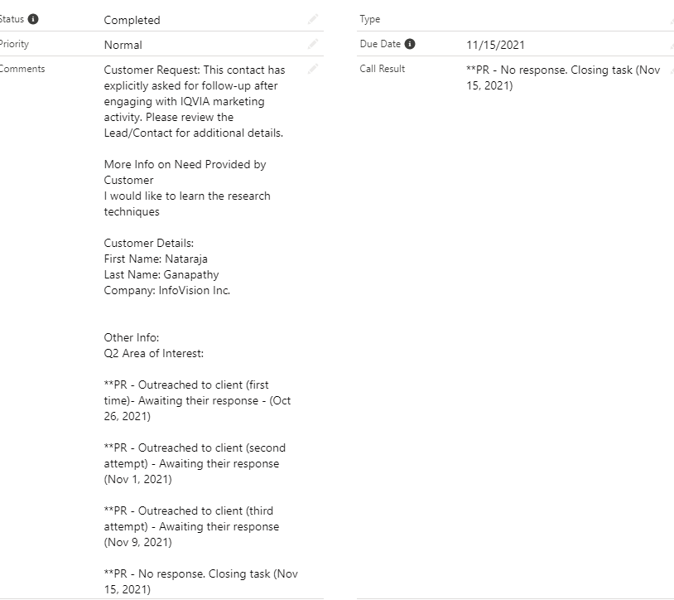
Inside Sales Follow Up
MQL Status Updates and Notes by BDs
BDs will update the status reflecting where they are in the process
Open – Attempt 1,2,3,4,5
Other key statuses
For a MQL to be completed, messaging in the call result field must be added
BDs will leave a note in either the comment section of the MQL or the call result field with details
Status | Description
Notified BD | No sales opportunity at this time, but BD has traction with lead/account and has been made aware of recent site interaction
Waiting on someone else | Waiting to gather more information from BD, SME, etc but will continue to follow up until status complete
Already engaged | Engaged with the account on that particular offering already
Advanced relationship | Advanced the discussions and hoping to lead to an opp in the future, but not opportunity right now
Completed | MQL has been completed/the set cadence has been met with no traction gained from the lead
Opportunity Created | MQL and outreach interaction has resulted in an opportunity for the offering, will be linked in the Related To field at top of MQL

Slide 26
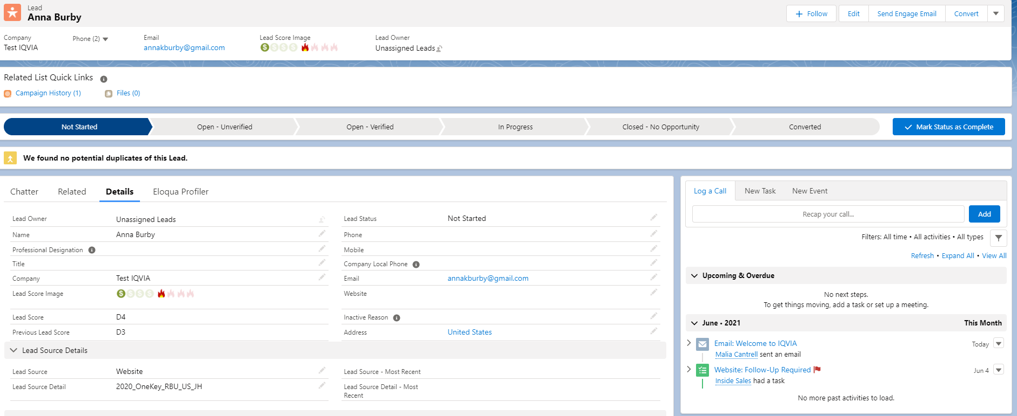
Documenting all attempts on CRM profile
Email to salesforce and Eloqua tracking

Slide 27
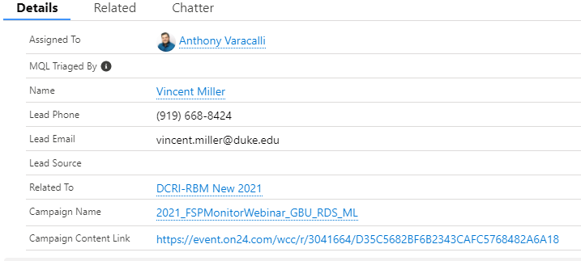
Linking Opportunities to MQLs
Salesforce
GIS BDs will ensure that if opportunities result in the marketing efforts, that the opp is linked in the Related To field of the MQL task and has the campaign name listed as the primary campaign source in the opp
Detailed slides on how this is accomplished in appendix

Slide 28
MQL Tracking & Reporting

Slide 29
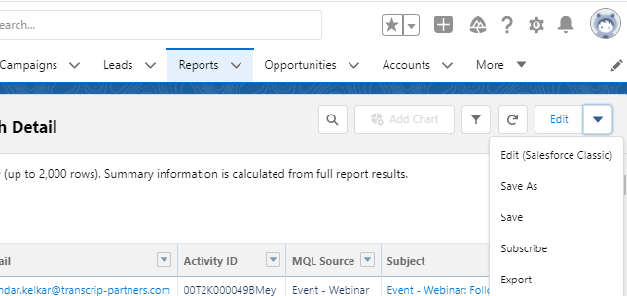
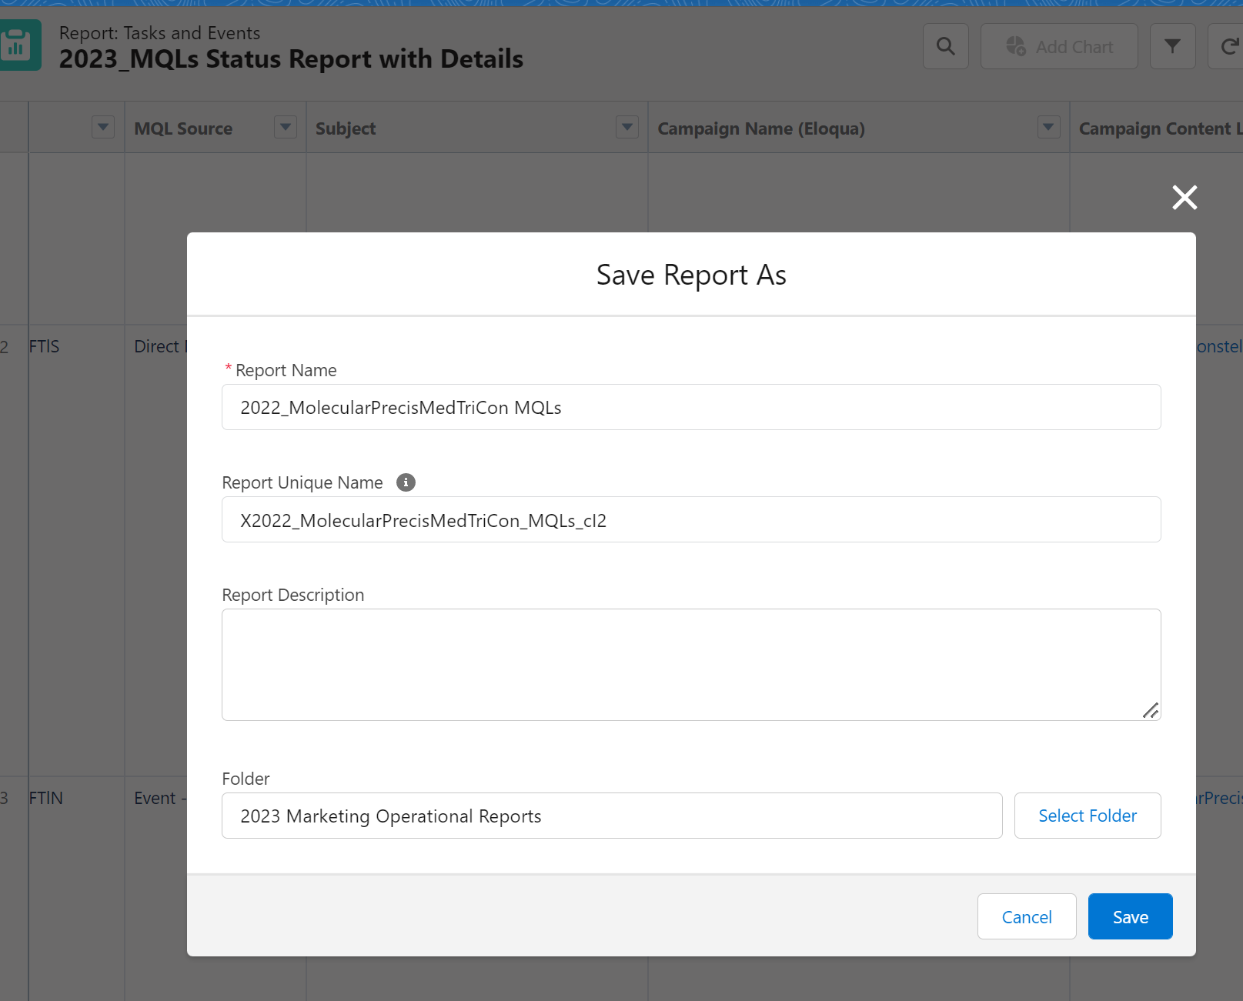
Steps to pull an MQL Report from your campaign
How to look up MQLs from your campaigns
Example campaign: 2022_MolecularPrecisMedTriCon_USCAusa_SC
Open Salesforce (If you do not have access or need to reactive your account click here)
Open the 2024_MQLs Status Report with Details report here
Open the 2023_MQLs Status Report with Details report here
Click on the dropdown arrow in the top right-hand corner: Click “Save As”
Enter your report name:
Example: 2022_MolecularPrecisMedTriCon MQLs > Click Save

Slide 30
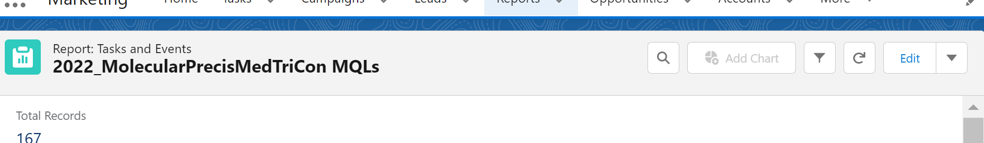
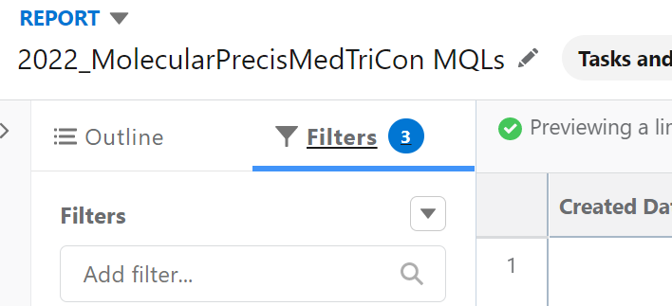
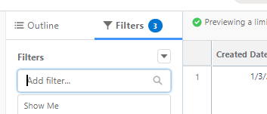
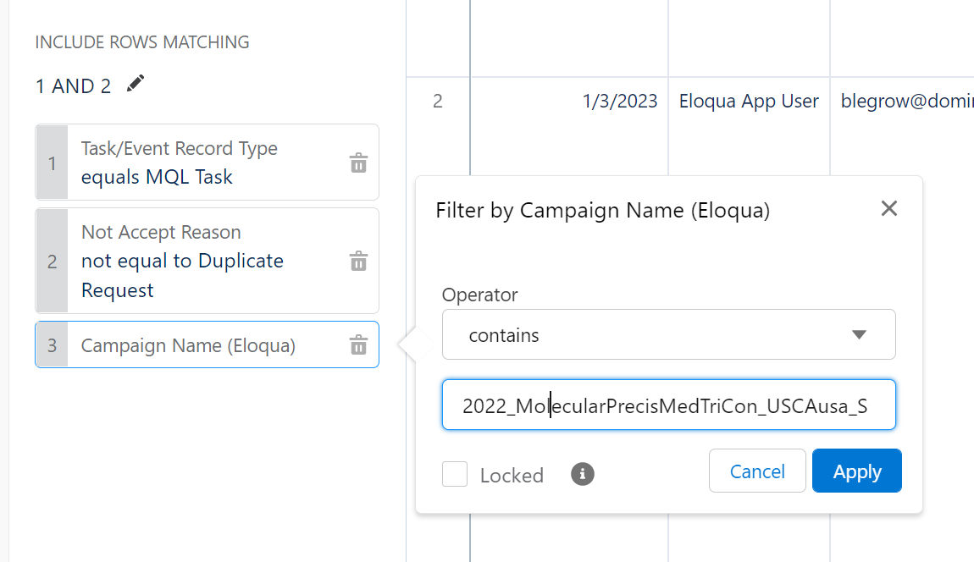
Steps to pull an MQL Report from your campaign
How to look up MQLs from your campaigns
Click “Edit” in the top right-hand corner:
Click the “Filters” tab on the left hand side
Click into the “Filters” field to add a new filter (Add “Campaign Name (Eloqua)” Filter)
Change the Operator to “contains” and put your campaign name in the box and click “Apply”

Slide 31
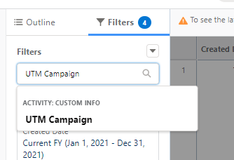
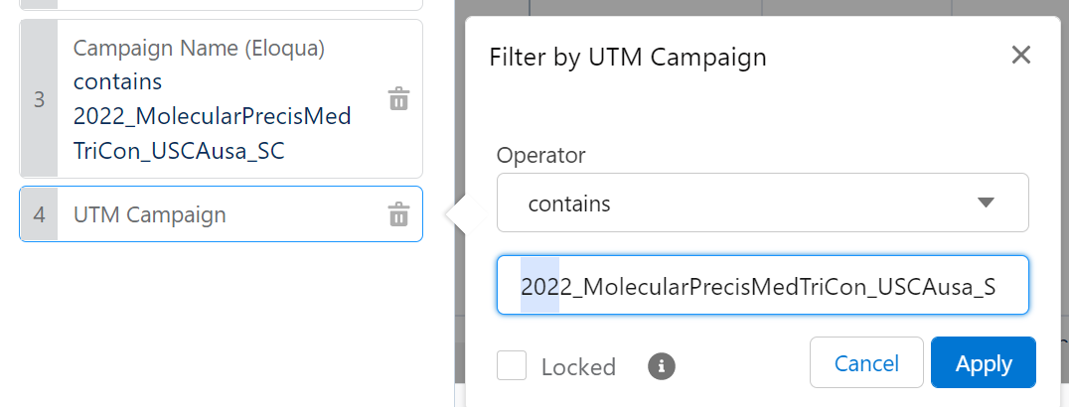
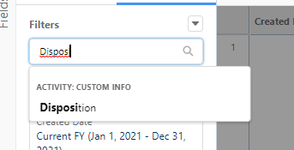
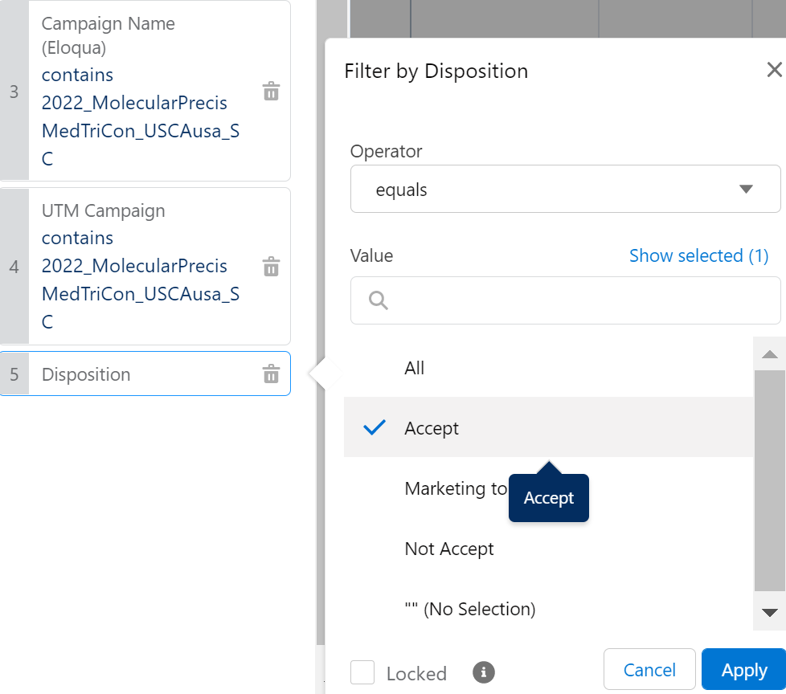
Steps to pull an MQL Report from your campaign
How to look up MQLs from your campaigns
Add a new filter “UTM Campaign”:
Change the Operator to “contains” and put your campaign name in the box and click “Apply”
Add a new filter “Disposition”:
Keep the Operator as “equals” and select “Accept”

Slide 32
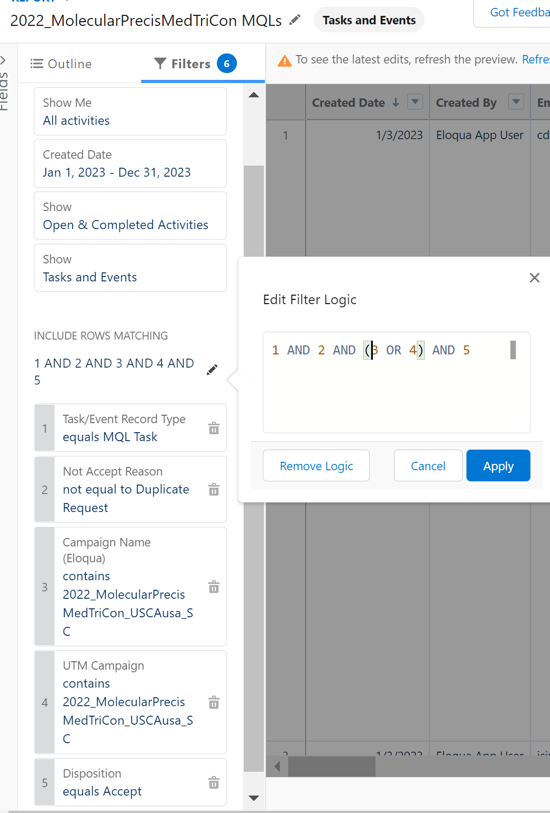
Steps to pull an MQL Report from your campaign
How to look up MQLs from your campaigns
Update the Filter Logic. Click on the pencil:
Click Save & Run:

Slide 33
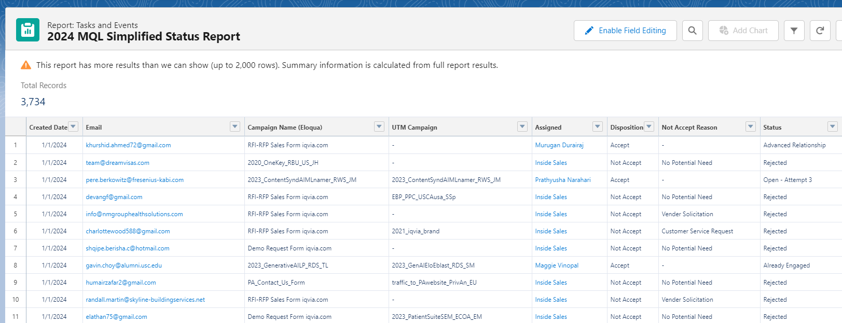
Simplified report to check on the statuses of MQLs
MQL Simplified Status Report
https://iqvia.lightning.force.com/lightning/r/Report/00O5c000007dpZYEAY/view?queryScope=userFolders

Slide 34
Enable Effective MQL Follow up
MQL Journey Takeaways
Campaign Triage Instructions
Marketers provide triage instructions for the Pipeline team to direct MQLs
Campaign Playbook
Marketers upload Playbook to Campaign with overview, messaging and engagement support for followup
MQLs
Standard IS Follow Up
Strongly recommend leveraging the standard Inside Sales follow up process
Salesforce MQL Reports
Use the existing Salesforce MQL reports to track and report on MQL status and followup with sales as needed

Slide 35
Open QA/Discussion

Slide 36

Questions and Answers from the chat
Where do you get the triage instructions from - in the submission form, in the sales playbook?
Could be a couple of different ways! Through manual uploads Srujana is great about adding the instructions in the upload email notification if they are provided to her. If not, I look at the campaign code in CRM to see the playbook or the triage instructions field and if they are not there, I will reach out directly to the marketer. They can also be included within Eloqua form fields.
Are these Playbook templates available on the Marketing Ops page?
I have a couple of samples that I can make sure to pass off to you after the call
Word Template
PowerPoint Template
Where In addition to the playbooks, should triage instructions be placed in both the triage instruction field of the campaign record in CRM and the description fields? Last I heard, not all Inside Sales and pipeline people have visibility to the triage instruction section. Is there any word on fixing that issue?
Would recommend placing the triage instructions in both the playbook and the triage instructions field. The pipeline team is the only team within GIS that have access to see the Triage Instructions field as it is really only important to our process. if the same information is within the playbook attached to the campaign, all of GIS can see that.

Slide 37
Questions and Answers from the chat
Question on the timing for Inside sales outreach. Seems like they get closed quickly. I'm wondering if we could have a final outreach or two a month or two later...Sometimes someone may be busy right after an event and needs time to process.
Typically if a marketing event does not fall under the "RDS/EBP" umbrella or any of the specialty teams within GIS, we see the trend of them being assigned outside of GIS. If they do end up being assigned within GIS then we can connect during the development of the playbook, so pre-MQL generation, and see which specific team would be ideal and to make sure all information is included.
Do we have metrics that show how often that cadence is followed?
I do not think so as this would be a very manual process. It would involve tracking the status of the MQLs and also tracking the due date to see how often/when that was pushed back. As well as going to the lead/contact record to see if the traction was logged.
Where Inside Sales resources are not dedicated and aligned to specific solutions knowledge in a business unit, what is the best way to engage with the GIS team prior to campaign launch, to ensure they are knowledgeable and conversant on the campaign in order to improve marketing pipeline contribution?
Typically if a marketing event does not fall under the "RDS/EBP" umbrella or any of the specialty teams within GIS, we see the trend of them being assigned outside of GIS. If they do end up being assigned within GIS then we can connect during the development of the playbook, so pre-MQL generation, and see which specific team would be ideal and to make sure all information is included.

Slide 38
MQL conversion process in Salesforce

Slide 39
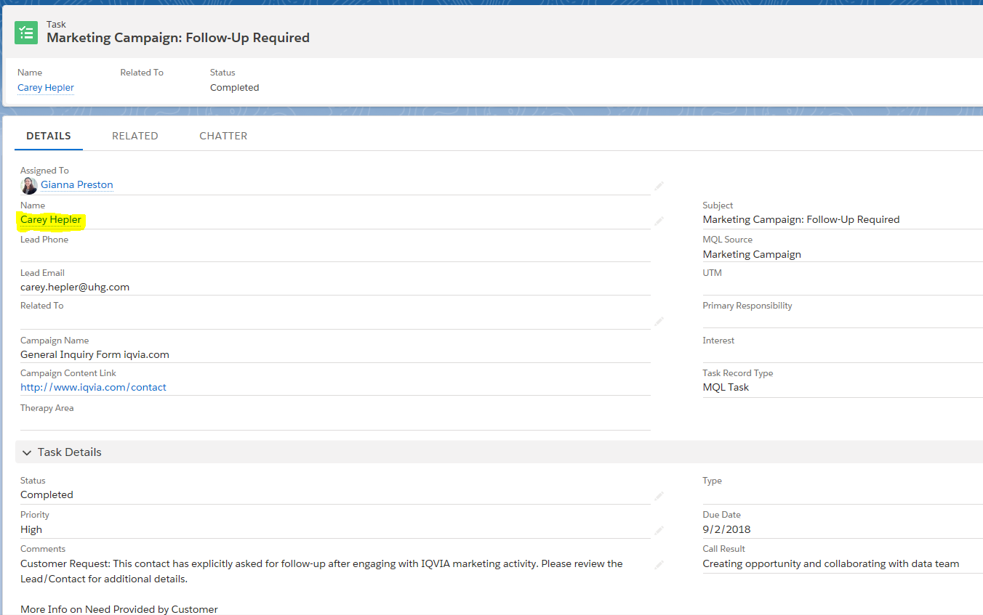
MQL Conversion Process
When the MQL comes in from a lead in CRM
This is a visual of an MQL in Salesforce
To begin the conversion process, click on lead’s name within the MQL

Slide 40
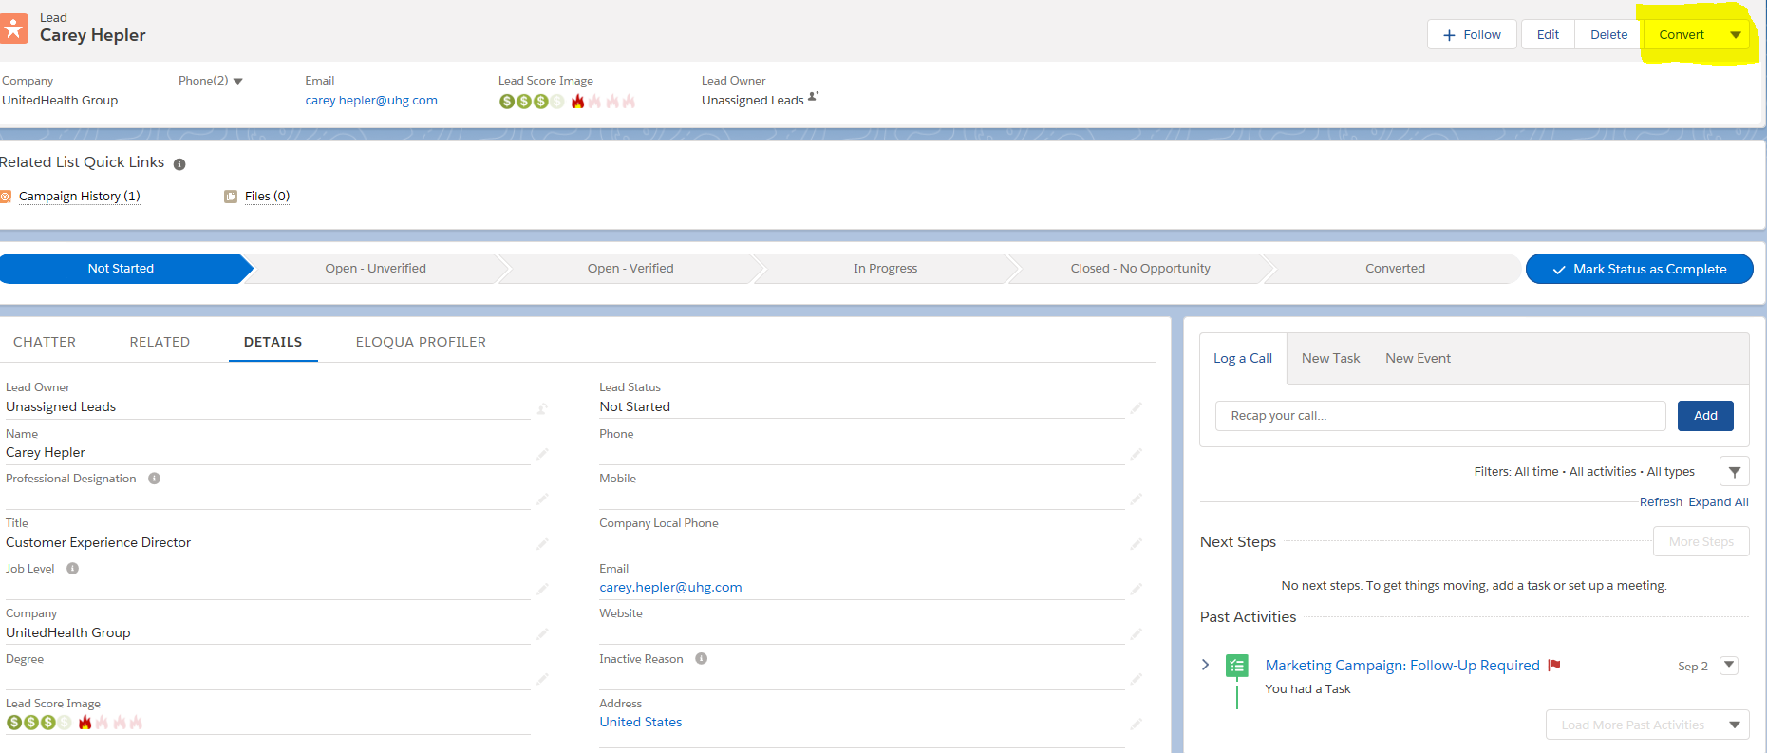
Lead Record
Click Convert
Visual of Lead Record in Salesforce
To move forward, click Convert

Slide 41
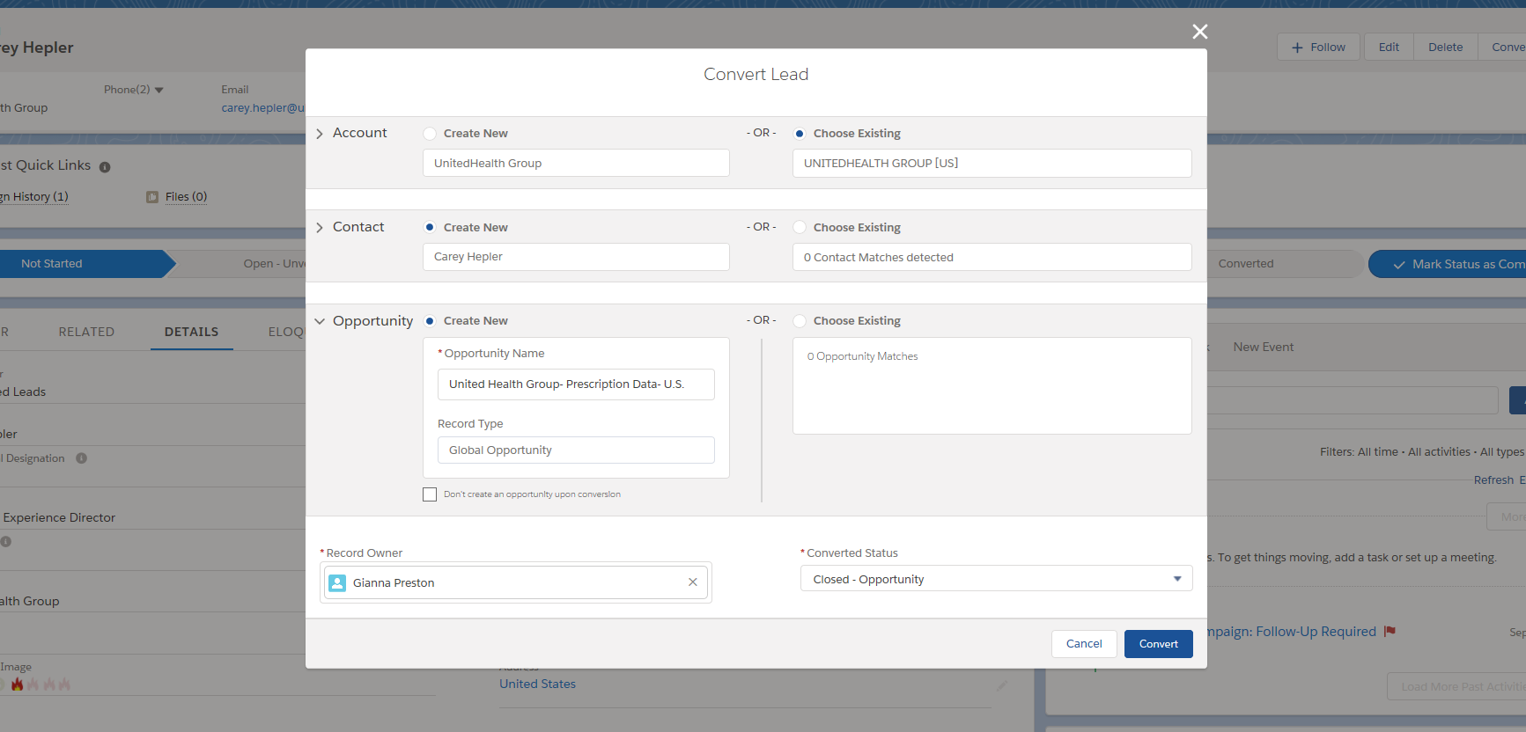
Final 3 Steps to Complete Process
Next steps
Create New account (if it does not exist already)
If an account does exist, select ‘Choose Existing’ and copy and paste the exact account name found in CRM to ensure the opportunity attaches right account
Create New contact (if it does not exist already)
If a contact does exist select ‘Choose Existing’, the box below this will tell you there is a match found, you can choose that name found in CRM.
Create New Opportunity *this will link the opportunity with the lead and MQL campaign source*
If you’re converting the lead after creating an opportunity and need to attach these, select ‘Choose Existing’, then copy and paste the exact opportunity name found in CRM to ensure the contact attaches to the right opportunity
Use this box if you do not want to create an opportunity in the beginning. *But remember, you will need to link the opportunity should one arise later in your discussions.

Slide 42
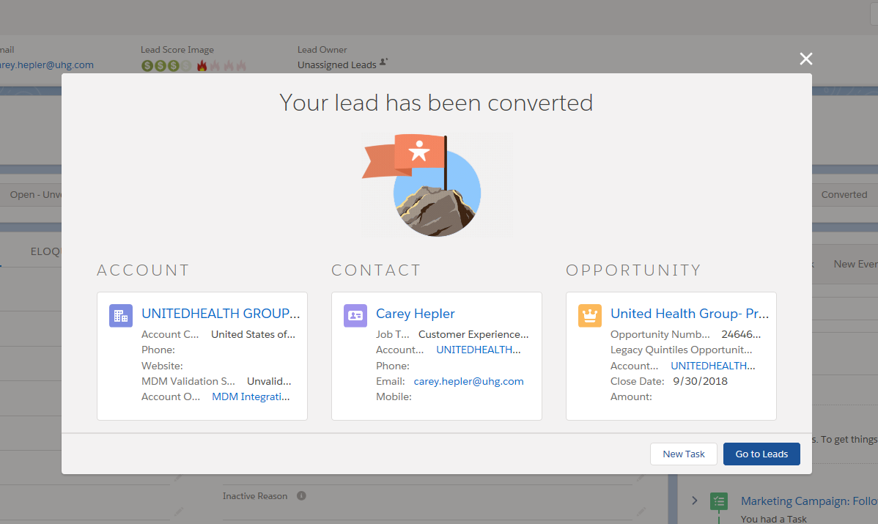
Confirmation of Conversion Process
Confirmation
You can use any of the blue links to go directly into the account, contact, or opportunity.
Let’s go into the opportunity to see the MQL linked.

Slide 43
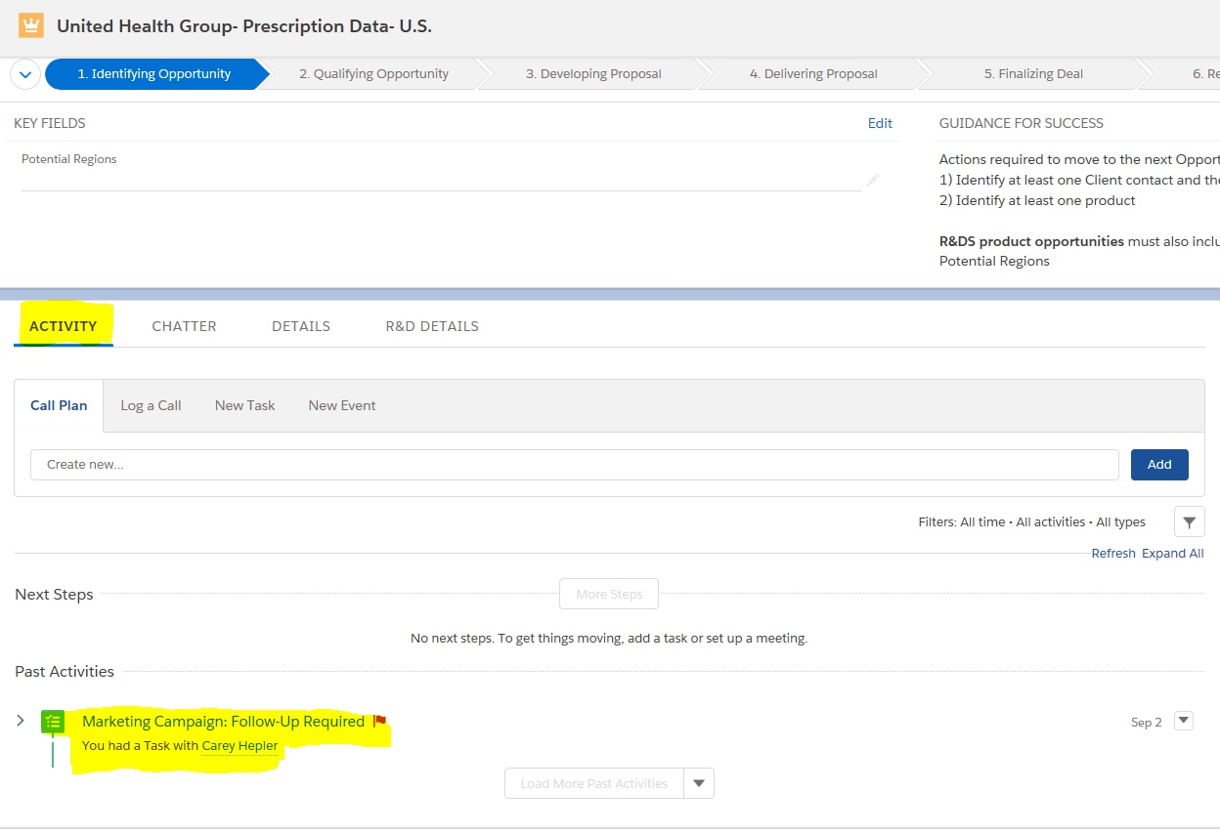
Confirmation of MQL / Opportunity Link
Red Flag
When inside opportunity, click the Activity tab
Look below in the Past Activities section, you should see an activity with a RED flag, that flag indicates the task is a MQL

Slide 44
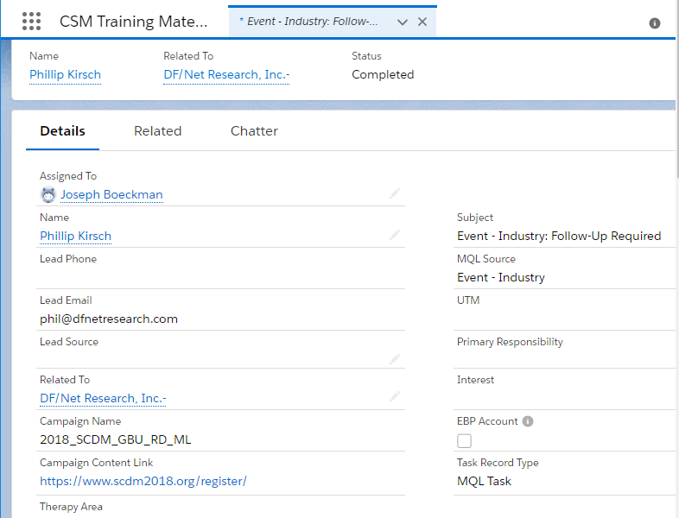
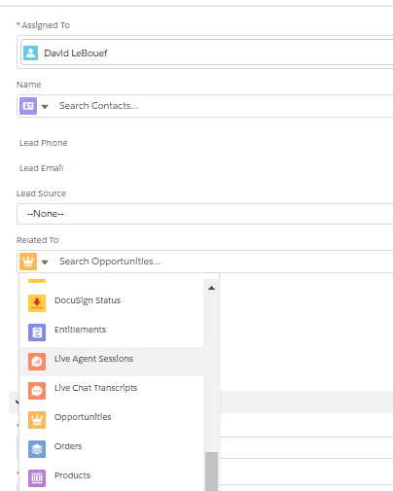
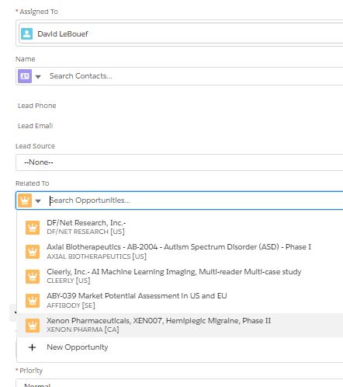
How to Associate an MQL Task to An Opportunity
When the MQL comes from a contact in CRM
1
Open MQL Task Record In Salesforce
2
Select “Related To” field and select Opportunities
3
Select Opportunity Name

Slide 45
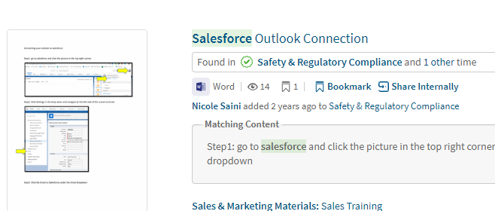
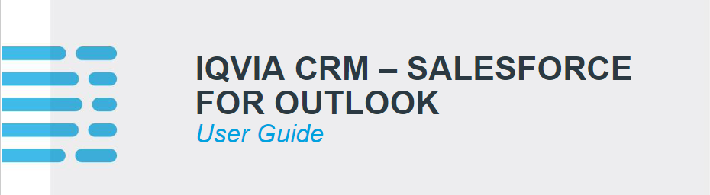
Sales Spot Links for tracking emails in salesforce
Utilizing the BCC function and the salesforce app in Outlook
1
BCC Function
2
Salesforce App in Outlook

